Slide 1
Radio Controlled (RC) Model Aircraft Airpark Development DISCUSSION
DESERT Fox fliers

Slide 2
Purpose
To start a dialogue with the City of Mesquite regarding establishment of an airpark suitable for radio controlled model aircraft use.
The sport of aero modeling is as normal as golf or tennis.
It takes less space than golf, and it can cost a lot less than fishing, so it doesn’t have to be a rich person’s sport.
People with certain disabilities can participate.

Slide 3
Proposal
City land for airpark with oversight provided by the Desert Fox Fliers.
Desert Fox Fliers would be the host club, offering airpark liability insurance through their charter from the Academy of Model Aeronautics (AMA).
Airpark would be open to members of the Academy of Model Aeronautics, and members of local area clubs with current AMA membership.
Notes:
NOTE: 2.5 MILLION DOLLARS Primary insurance provide by the club to the Site Owner

Slide 4
Proposal continued
Access to the site could be controlled via issued use permits
Yearly permits (All Desert Fox Flier club members).
One-time use permits (day/weekend/other).
Permits issued only to those holding current year AMA membership cards (proof of liability insurance).
Permits offer simple way to verify permission to use site/proof of liability insurance.

Slide 5
Proposal continued
Desert Fox Fliers would work with the City to develop a site plan, based on available land, its size, shape, and surroundings.
Desert Fox Fliers would be allowed to make site improvements (governing City approval).
Runway / pit area / pilot stations
Shelter (shade/wind/sun…)
Parking area
Spectator area
“Porta-Potty”
Other

Slide 6
Proposal continued
With proper planning and execution, with support from the City and the Desert Fox Fliers, the site could become a “destination” for model aviation enthusiasts, visitors and tourists.
Long-term plans could allow Desert Fox Fliers to offer radio controlled modeling activities; just like the traditional soccer, baseball, football, swimming, and arts/crafts offerings in Mesquite.
Notes:
Might want to expound on revenues generated by visitors

Slide 7
Benefits
Another City supported park that would bring a different opportunity for recreation than other City parks provide.
Potential to attract new residents.
OnTopOfTheWorld.com advertisement
“Live Here. Fly Here. Love It Here.”
“With an Ocala, Florida location, over 250,000 sq. ft. of amenities and your own R/C flying field nothing in Active Adult living can compare.”
Grows ties to “engineering-minded” individuals.
Retired professionals
People who enjoy doing things with their hands
Individuals move into another phase of life (retirees, veterans, disabled persons, etc.).
Involve younger people in the hobby. (Neil Armstrong, the first man on the moon, began his career as an aero modeler.)
Revenue stream to City from visiting hobbyists and families, and new residents.
Prime location to hold events during winter months.
Individuals not healthy enough for other hobbies may enjoy this hobby.
The community receives many benefits from allowing land to be used for such worthy purposes as family togetherness, healthy competition and the promotion of a viable and respectable hobby/sport.

Slide 8
Desert Fox Fliers
Established 2000
The Club is chartered and insured by the Academy of Model Aeronautics and holds a State of Nevada Corporate Charter.
Membership open to the public at large, however members must join AMA for liability insurance purposes.
Currently 31 members; 20 are residents of Mesquite. Other Sun City residents have shown interest and preparing to learn to fly!
Currently flying on State of Arizona-owned land that is leased by a third party for agricultural purposes.

Slide 9
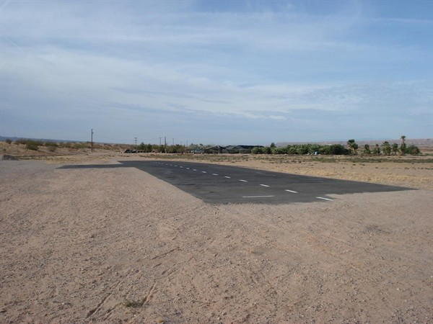
Desert Fox fliers Airpark
300’ x 40’ runway

Slide 10
Desert Fox Fliers continued
Our members build, fly, and maintain radio controlled model aircraft, which includes:
Sport aircraft
Scale aircraft
Helicopters
Sailplanes
Electric powered, “gas” powered, turbine engine powered, and un-powered
Desert Fox Fliers offers RC pilot instruction / training.
Emphasis on SAFETY and RESPONSIBILITY
Desert Fox Flier members can work with schools and other community organizations to promote aviation and spark interest in science and technology education.

Slide 11
Proposed airpark Site Plan
To be determined based on City land availability.
Optimal Minimum Requirements
A properly oriented (with respect to prevailing wind) takeoff and landing strip of sufficient size to accommodate the largest models;
A pit area to service the models, possibly with interconnecting taxiways to the main strip;
A centralized control zone for the pilots to stand;
An unobstructed flight pattern area—especially with respect to the landing strip approaches.
The flight area should be a minimum of 1,000 feet by 4,000 feet, oriented so that the longest dimension parallels and is centered on the landing strip.
A minimum of 300 feet should be established between the landing strip and the car park area.

Slide 12
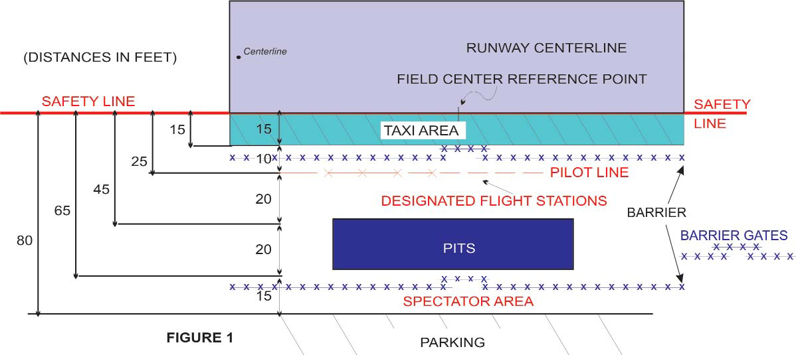
Generic airpark Operation Layout
AMA Safety Code is the governing factor
No landings or takeoffs from the taxi area
Barriers designed to stop taxiing models from veering into pilot or spectator positions
Pilot line set back from runway edge for safety
Public notice signs to be posted
Safety equipment available
About 5 acres needed for airpark operation

Slide 13
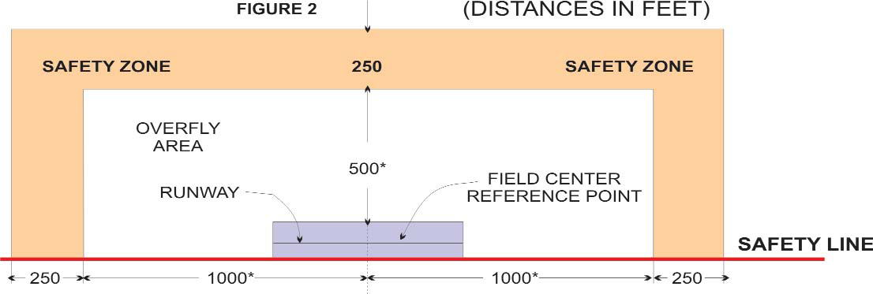
airpark Flight Area
2,000’ x 500’ Overfly Area per AMA guidelines
Additional 250’ safety zone is desirable
Flight area clear of potential hazards
Alternate site layouts (parallel runways, cross runways, etc.) are possible
43 acres of overfly area desired for potential jet operations

Slide 14
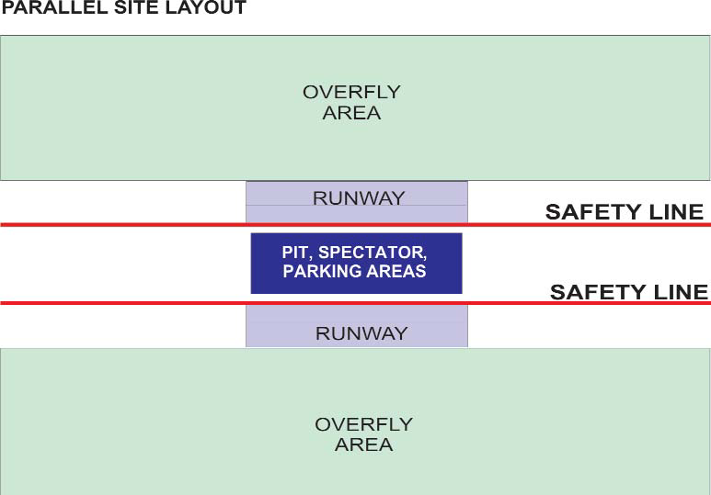
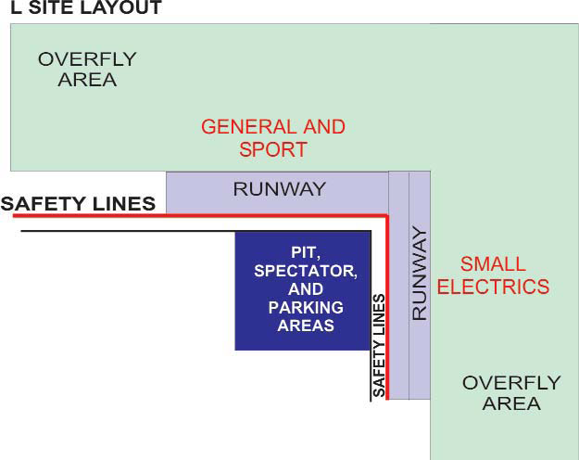
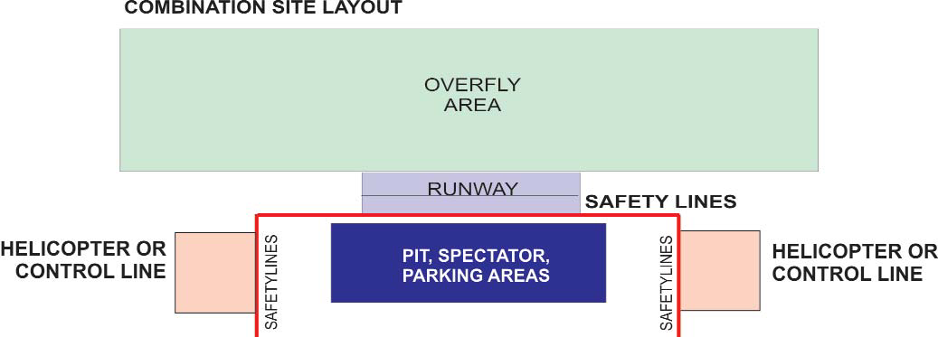
Alternative Layouts
Optimal Layout

Slide 15
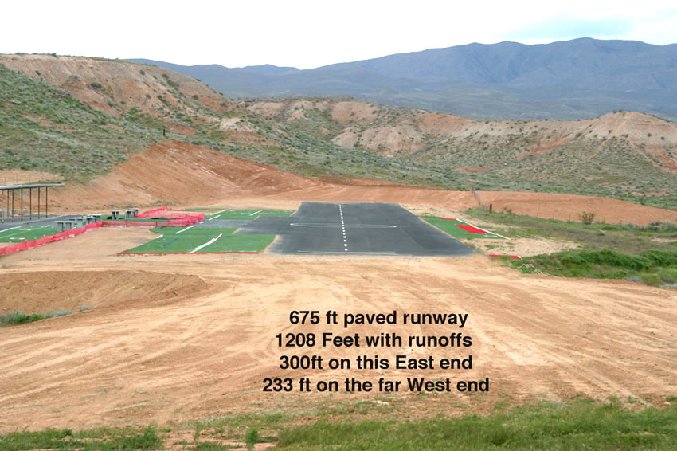
Remote Possibilities RC Club – St. George

Slide 16
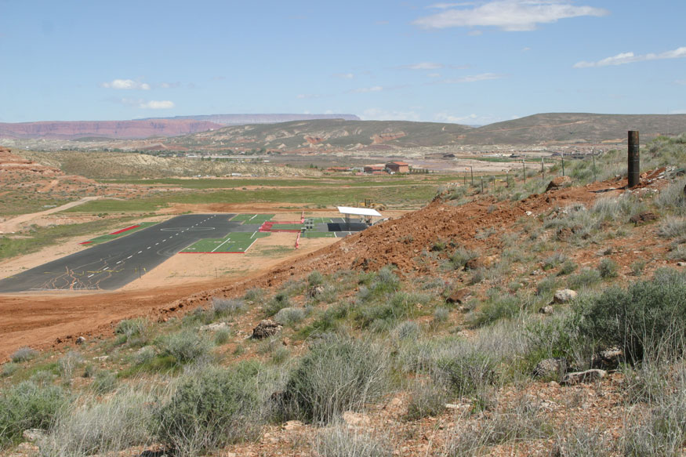
Remote Possibilities RC Club – St. George

Slide 17
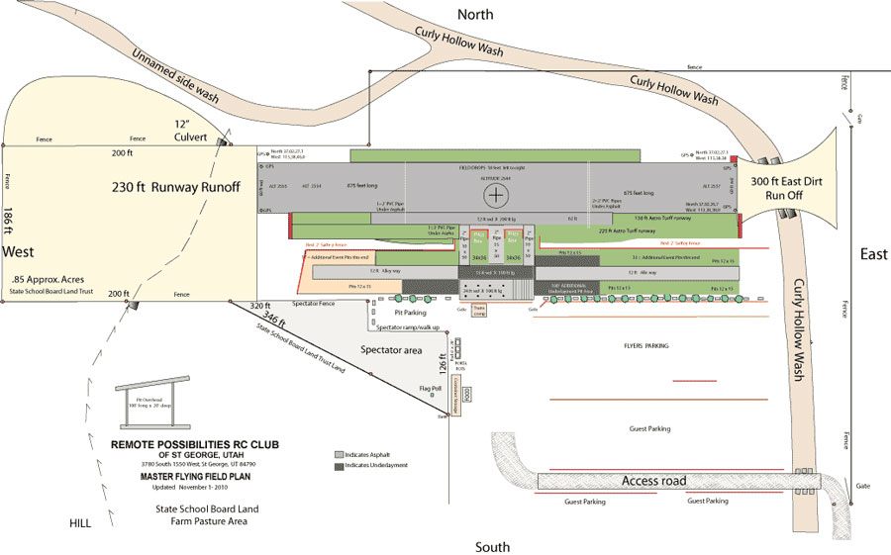
Remote Possibilities RC Club – St. George

Slide 18
Remote Possibilities RC Club – St. George
Airpark is on land donated to flying club by City of St. George.
Three acres are leased from the School Trust Lands (BLM).
Flying club paid for all land improvements.
Airpark is utilized 7 days a week.
Revenue generating events are held at airpark annually.
Pilots from all over USA (Feb 2014 event was 60 out-of-town pilots and families
Some pilots stay in Mesquite for entertainment
Some pilots stay in St. George and gambled in Mesquite

Slide 19
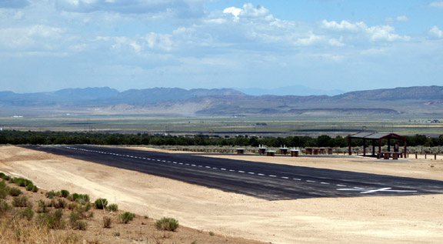
Cedar City radio control club
685’x 50’

Slide 20
Cedar City radio control club
Part of the Three Peaks Recreation Area – BLM owned land.
Recreation Area open to everyone.
Club paid $8000 toward land improvements. BLM paid the rest of money needed.

Slide 21
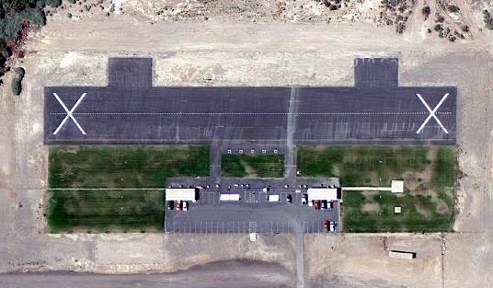
William Bennett RC airfield – Las Vegas
100’ by 700’ east/west runway with pit areas for competition and two large shade shelters for spectators

Slide 22
William Bennett RC airfield – Las Vegas
Bennett Field is named after Bill Bennett, a major owner of several Nevada Casinos, and an avid RC enthusiast.
Mr. Bennett personally financed the construction of two model aircraft fields in Las Vegas.
Only one remains. Known as the William G. Bennett Radio Control Aircraft Field.

Slide 23
Academy of Model Aeronautics
Official national body for model aviation in the United States; established in 1936.
~165,000 members worldwide. 2400 clubs.
AMA estimates more than 1M modelers nationwide.
Provides membership liaison with –
Federal Aviation Administration (FAA)
Federal Communications Commission (FCC)
Transportation Safety Administration (TSA)
National, state, local governments/agencies
Provides $2.5M of primary liability insurance for –
Flying site owners
Chartered clubs
Individual members
City named as “additional insured”

Slide 24
Funding
Desert Fox Fliers does not have cash to fund project
Possible funding sources-
City
Federal Government; National Park Service – Nationwide Outdoor Recreation Plan (Chapter 6 – Model Aviation and Club Activities)
State Government
Casinos
Walmart
Veterans Organizations
Fund raising activities
Individual contributions

Slide 25
Where do we go from here?

