Slide 1










Georgia Model Aviators
Georgia Model Aviators
Building Value in The Community, Local Economy and Family
Presentation on behalf of:

Slide 2



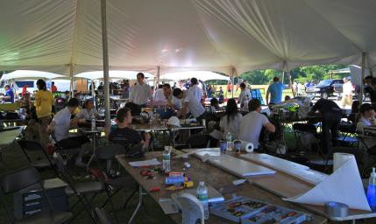



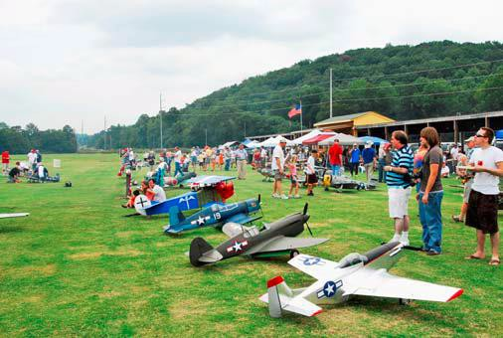




Purpose
Purpose Background Community Impact
Field Operation Layout
Field Needs Proposal
Georgia Model Aviators is seeking property for lease that can accommodate our club of 350+ members to:
Promote Aviation
Community Outreach
Recreation
Education

Slide 3


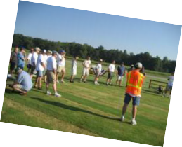


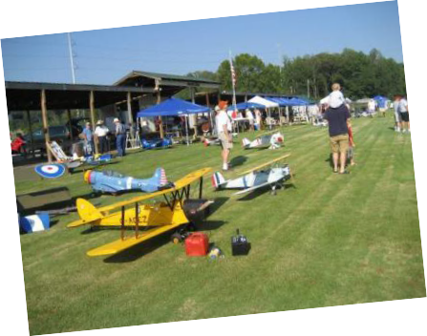
Background
25 Years / 350 Members
– Children thru Seniors
Current location for 11 years:
8250 Old Federal Rd Ball Ground, GA 30107
Non-profit 501(c) 3
National recognition of members
Website: www.gmarc.com
Charter AMA club
Purpose Background Community Impact
Field Operation Layout
Field Needs Proposal
•
•
•
•
Academy of Model Aeronautics - Muncie IN
Official national body for model aviation in the United States More than 2,500 model airplane clubs across the country Membership of more than 150,000
– Self-supporting - non-profit organization Promotion and development of model aviation
•
Education
Safety regulations
Insurance
•
Provides liaison with the Federal Aviation Administration, the Federal Communications Commission, and other government agencies

Slide 4



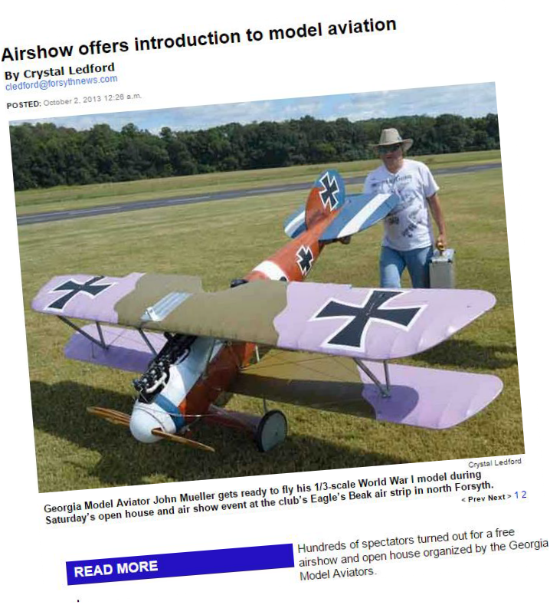
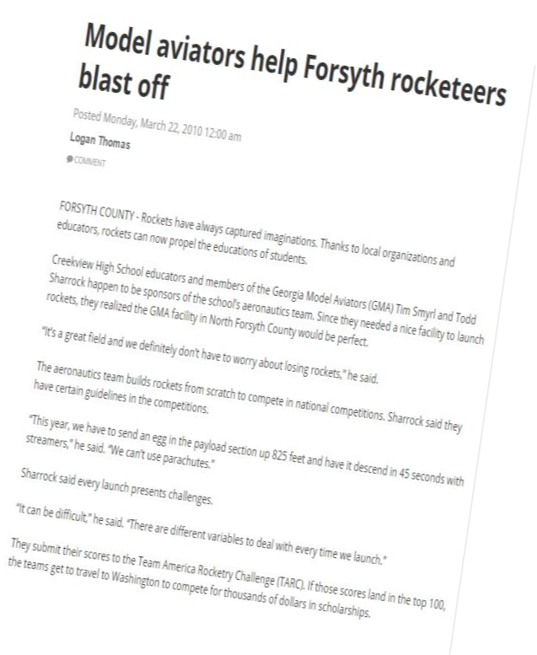
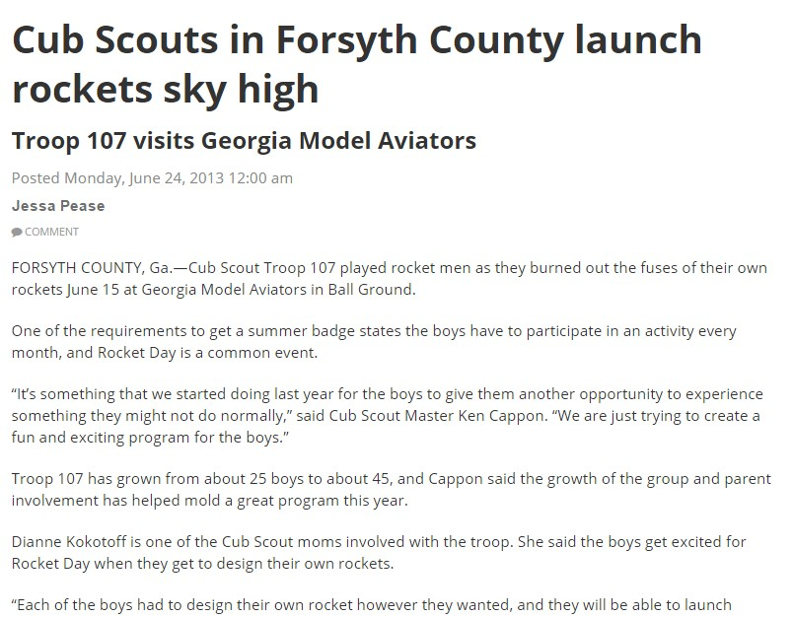

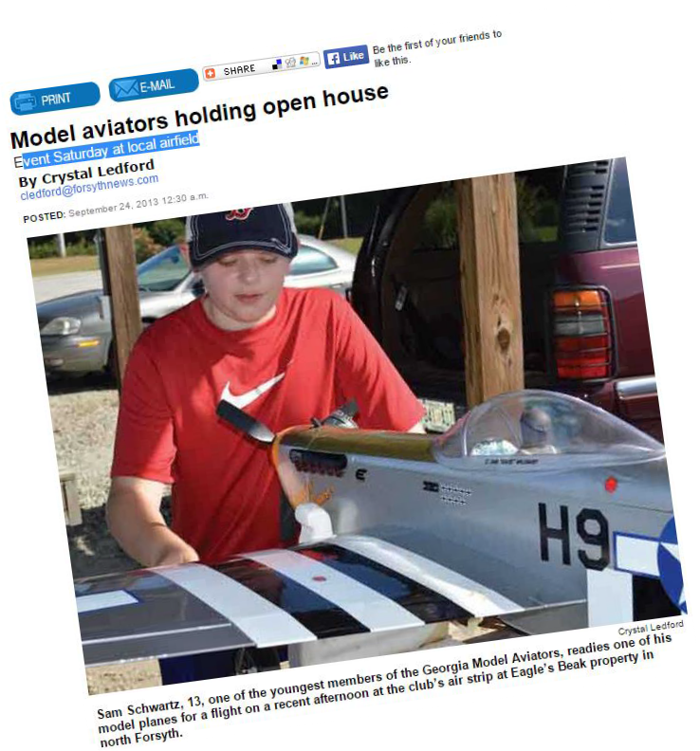
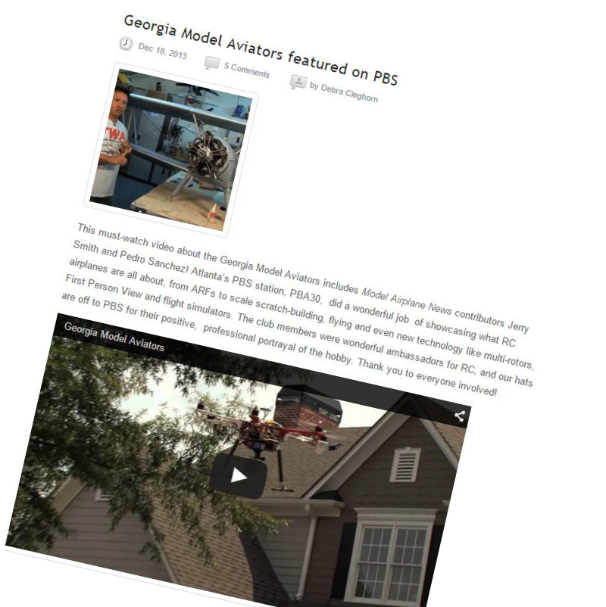

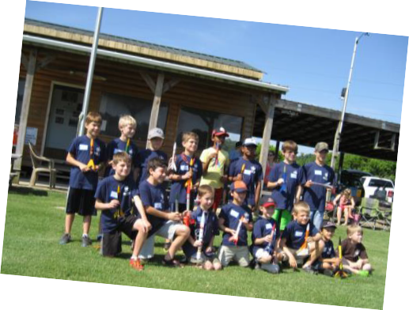
Supporting our Youth
Purpose Background Community Impact
Field Operation Layout
Field Needs Proposal

Slide 5


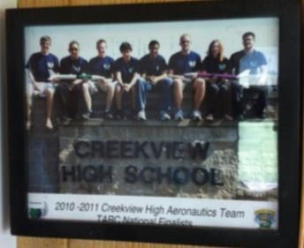
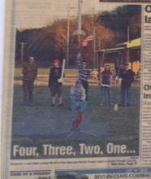
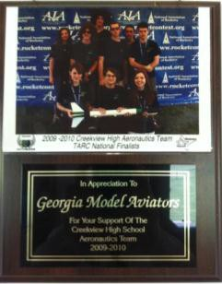
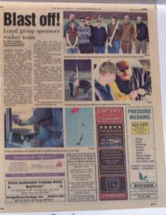
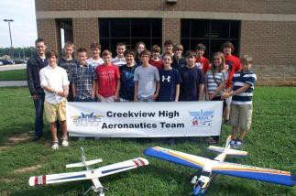
Supporting our Local Schools
Purpose Background Community Impact
Field Operation Layout
Field Needs Proposal

Slide 6




TARC Rocketry Challenge
TARC provides $60,000 in cash and scholarships split between the top 10 finishers
Lockheed Martin, Raytheon, NASA
7,000 students from across the nation
Purpose Background Community Impact
Field Operation Layout
Field Needs Proposal

Slide 7

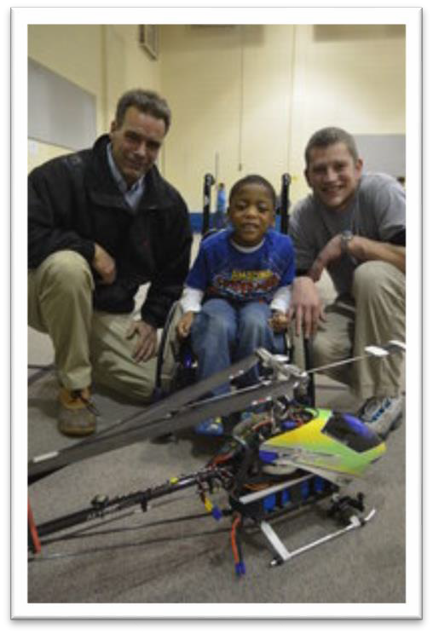
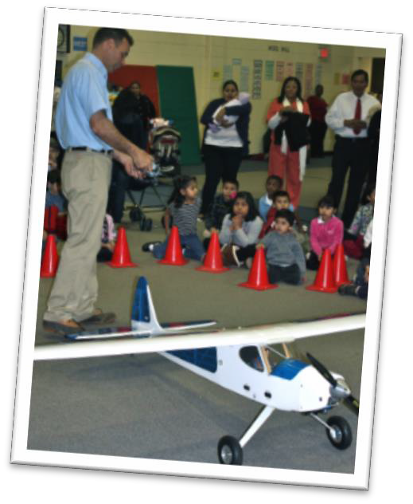
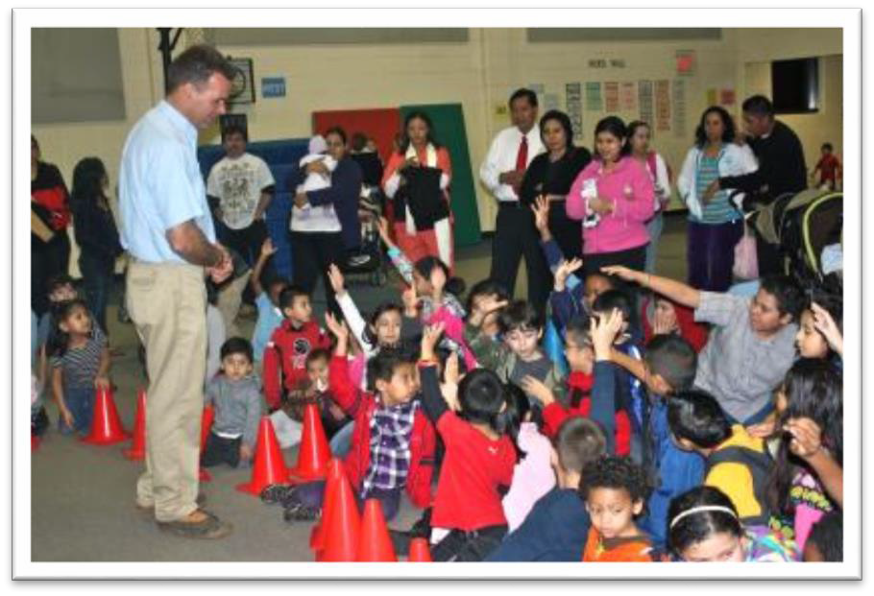
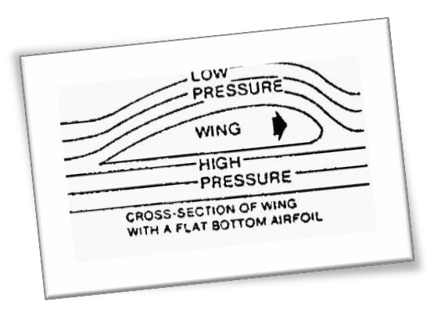
Educating our Youth –
Science Night
Purpose Background Community Impact
Field Operation Layout
Field Needs Proposal
Mimosa Elementary School
Thursday January 26th 2012
Guest science instructors from
throughout the community
7
Copyright © 2009 Georgia Model Aviators

Slide 8

Other Youth Groups
Purpose Background Community Impact
Field Operation Layout
Field Needs Proposal
Scouting
  Flying with a trainer
  Aviation related merit badges
Big Brother Big Sister
  North Georgia and metro Atlanta
  Visits to the field and flying with a trainer
Police Explorers
Little League Teams
Copyright © 2015 Georgia Model Aviators

Slide 9




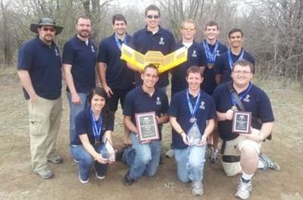

Working with Colleges
GMA - host to several SAE – Aero Design International Competitions
Purpose Background Community Impact
Field Operation Layout
Field Needs Proposal
Sponsored by
Collegiate competition
68 teams – 700+ students
World wide participation – 7 countries
Undergraduate and graduate engineering students
Held at GMA in 2012 returning in 2014, 2015 . . .
Georgia Tech First Place at 2012 SAE Aero Design East competition
(4/29/2012) Georgia Tech took first place out of sixty-nine teams in their division at the 2012 SAE Aero Design East competition in Forsyth County, Georgia, on April 29 th. The team had the lightest flying aircraft out of the twenty-seven entries into the Micro class. The airplane successfully carried over 3.5 times its own weight in payload. After building eleven prototypes with over 100 successful flights before the competition, the team was confident in the reliability and performance of the design even beyond the payloads flown in the competition.
9

Slide 10


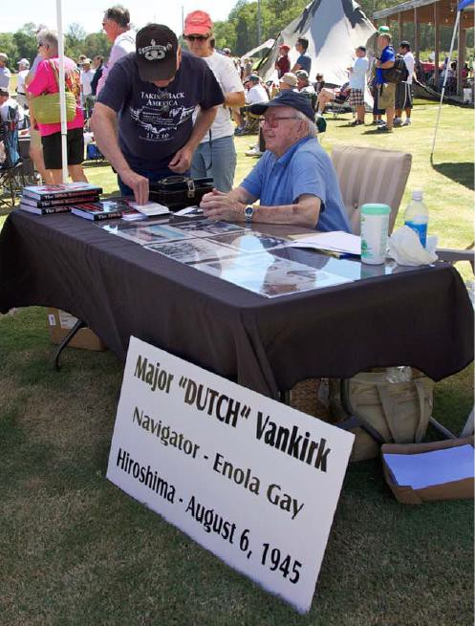

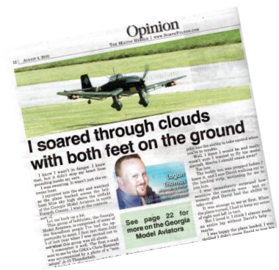


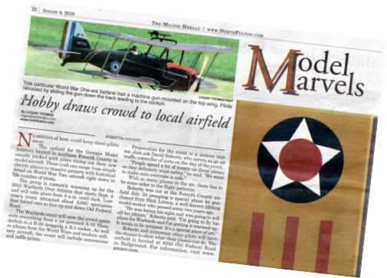
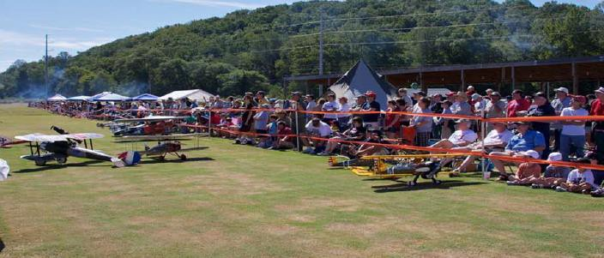
Public Recreation
Typically one event per year
Purpose Background Community Impact
Field Operation Layout
Field Needs Proposal
Community participation
Advertise in paper
3,000-5,000 attendees from Forsyth, Cherokee, and Fulton
On typical weekend many spectators drop by to picnic and watch the planes
Copyright © 2015 Georgia Model Aviators

Slide 11


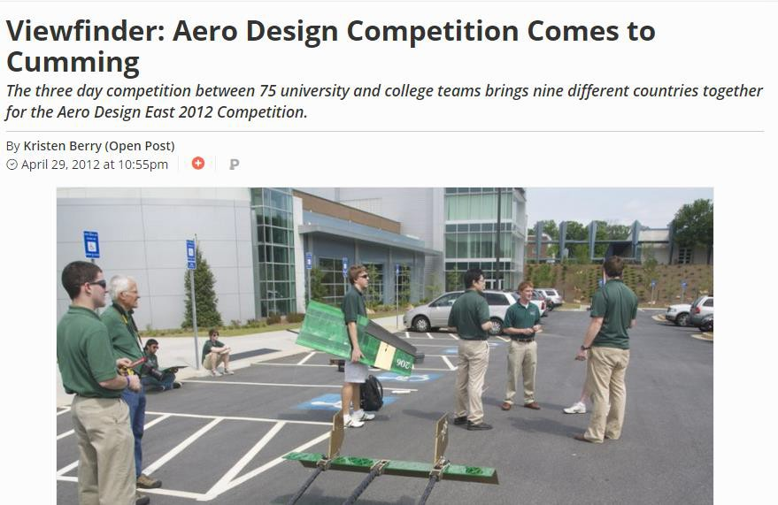
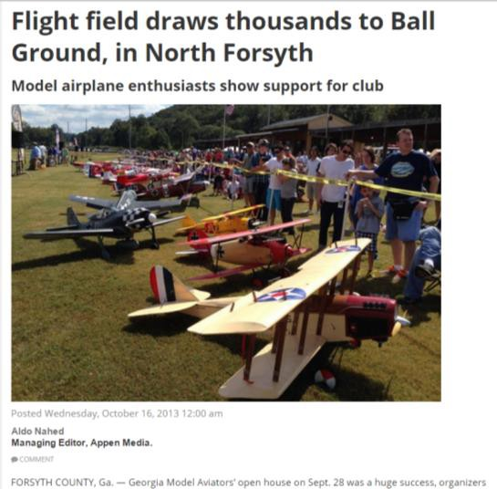
Economic Impact
November 2014
62+ Pilots from 13 states
1000+ Attendees
$70,000
April 2014
1000+ Participants
75 University and College Teams
9 Countries represented
Sold out hotel Rooms in Forsyth County (Wed-Sun)
Rented Lanier Tech Conference Center for two days
Worldwide recognition within the engineering community
$700,000+
Purpose Background Community Impact
Field Operation Layout
Field Needs Proposal
October 2013
3,500+ in attendance
$175,000

Slide 12




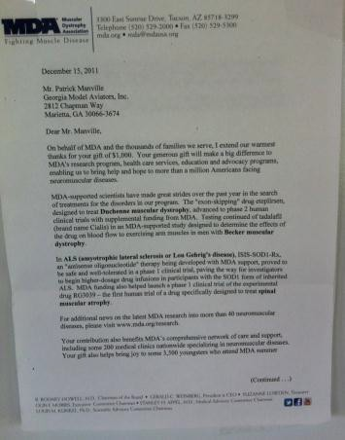
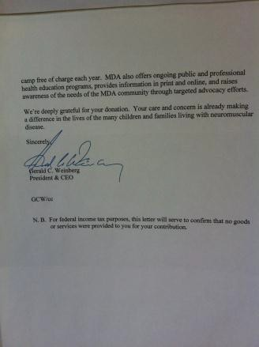
Charity - Giving Back
Purpose Background Community Impact
Field Operation Layout
Field Needs Proposal
Copyright © 2015 Georgia Model Aviators

Slide 13

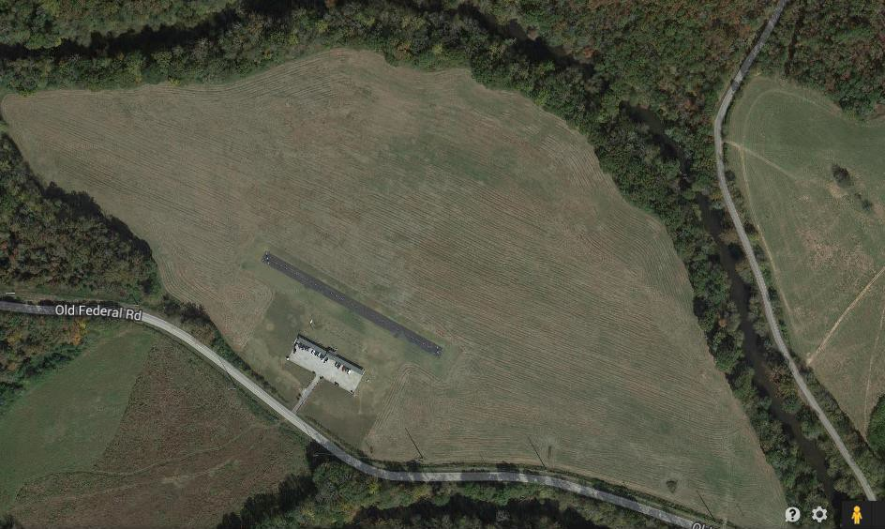
Current GMA Field
Purpose Background Community Impact
Field Operation Layout
Field Needs Proposal

Slide 14

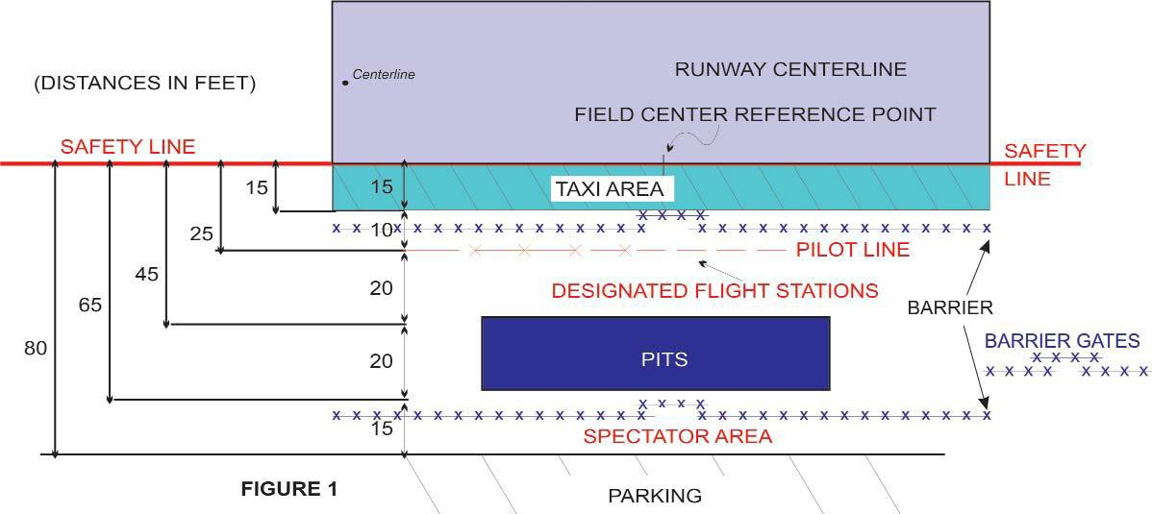
Field Operation Layout
Official AMA Safety Code is the governing factor
No landings or takeoffs from the taxi area
Barriers designed to stop taxiing models from veering
into pilot or spectator positions
Pilot line set back from runway edge for safety
Public notice signs to be posted
Safety equipment available
Purpose Background Community Impact
Field Operation Layout
Field Needs Proposal

Slide 15

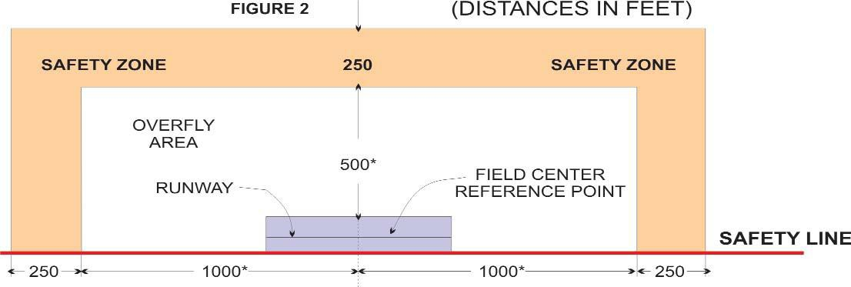
Field Needs
2,000’ x 500’ Overfly Area per guidelines
Additional 250’ safety zone is desirable
Flight area clear of potential hazards
Alternate site layouts (parallel runways, cross runways,
etc.) are possible.
43 acres of overfly area desired
Purpose Background Community Impact
Field Operation Layout
Field Needs
Proposal

Slide 16

Proposal
Purpose Background
Field Operation Layout Field Needs Community Impact Proposal
GMA would work with the governing agency/land owner to develop a site plan, based on the available land, its size, shape, and surroundings
GMA would be allowed to make site improvements at their
own expense (governing proper approval).
Runway / pit area / pilot stations
Shelter (shade/wind/sun…)
Parking area
Spectator area
“Porta-Potty”
Other
With proper planning and execution, with support from the responsible agency/land owner and the GMA, the site could become a “destination” for visitors and tourists.

Slide 17

Summary
Promote Aviation
Community Outreach
Recreation
Education

