Slide 1
Introduction to Unmanned Aircraft Systems
Frank Beafore Executive Director SelectTech GeoSpatial AMF Springfield, Ohio 937-398-0313 SGAMF.COM

Slide 2
UAS……what’s in a name………….?

Slide 3
What is UAS?
An unmanned aerial vehicle (UAV), commonly known as a drone, is an aircraft without a human pilot on board.
Its flight is controlled either autonomously by computers in the vehicle, or under the remote control of a pilot on the ground or in another vehicle.
The term unmanned aircraft system (UAS) emphasizes the importance of other elements beyond an aircraft itself.

Slide 4
Other names for UAS
Names that may be used to describe a flying object or machine without a pilot on board aerial torpedo,
radio controlled vehicle
remotely piloted vehicle (RPV)
remote controlled vehicle
autonomous controlled vehicle
pilotless vehicle
unmanned aerial vehicle (UAV)
unmanned aircraft system (UAS)
drone
Notes:
The main challenge that faced early aerospace pioneers of piloted and pilotless airplanes alike was the issue of controlling flight once the flying object was up in the air.

Slide 5
The “D” Word
DRONE !!!

Slide 6
UAV/UAS Production History
Started with the Kettering Bug (1918)
Except for the German V-1, not much activity until after WWII
Radioplane and Others in the late 40’s
Today – Government and Non-Government

Slide 7
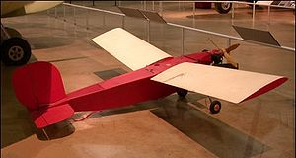
Norma from Radioplane
OQ-2 Radioplane - 1939
Norma Jeane Dougherty, June 26, 1945

Slide 8
Types
Fixed Wing
VTOL (Vertical Take-off and Landing)
Hybrid
Aerostat

Slide 9
Sizes
Large
Medium
Small
Micro

Slide 10
Historical Examples

Slide 11
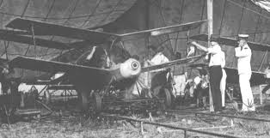
Kettering Bug with Sperry-Curtis Gyroscope
1918 (In Dayton)

Slide 12
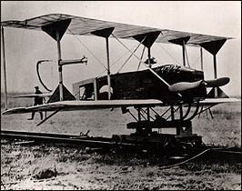
Sperry-Curtis Aerial Torpedo
Developed also in 1918 by Lawrence Sperry for the Navy
Lawrence Sperry was the developer of the autopilot
Work started initially as
underwater torpedoes
first guided missile
program in this country
Launched on March 6
1916 for 1000 ft
Never put into
production
Notes:
Airplane invented only 13 years earlier
Sperry worked with his son Lawrence to lead testing on Long Island

Slide 13
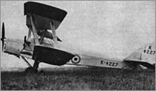
'Queen' and 'Queen Bee'
1931 the British developed the Fairey 'Queen from a Fairey IIIF floatplane
1935, a larger target was developed that was produced in much larger quantities: the 'DH.82B Queen Bee‘
This led to the designation of the letter “Q” for unmanned aircraft
The term “drone” is said to have originated from the Queen name “bee or drone”
Had wheels or floats depending on launch location
fly at an altitude of 5,182m at speeds of
over 160 km/hr and for up to 482 km

Slide 14
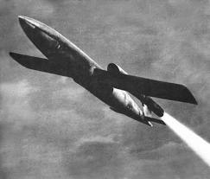
German V1
PulseJet Powered UAV in WW II

Slide 15
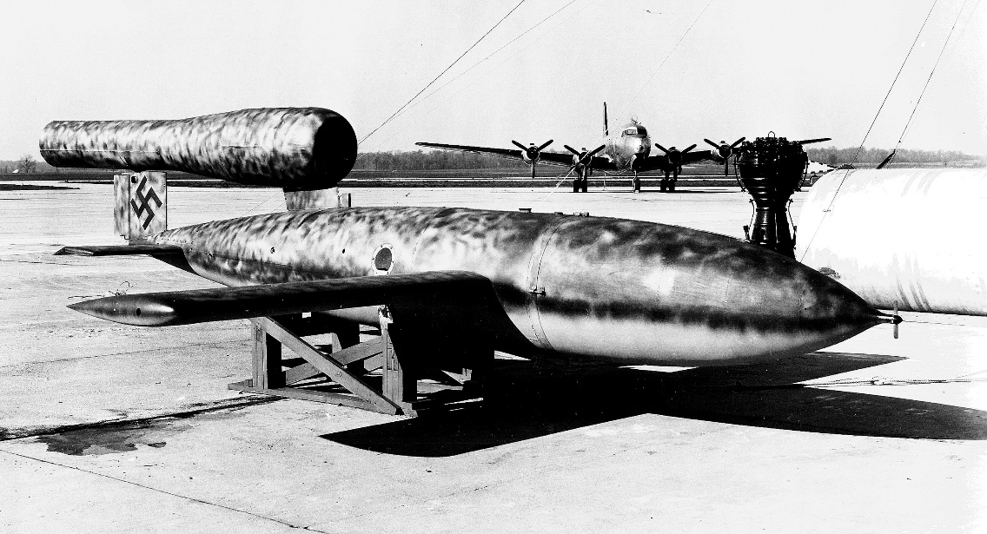
WWII German V-1 Buzz Bomb
Most significant UA of the war
The first mass-produced cruise missile
powered by a primitive yet powerful “pulsejet” engine which gave the V1 a loud noise heard 10 mi away (hence the name)
over 25,000 build
Could be launched both
by air or land
Used a powerful
pneumatic catapult system
Primarily employed from ground-launch rail systems
Notes:
It influenced future designs
World War II accelerated the development of aviation science in general and the unmanned aircraft in particular. Both the Germans and the allies successfully utilized unmanned combat aircraft. The most extensive program came about during the Vietnam War, as advances in technologies made UAVs more effective
The US Navy build a reversed-engineered copy fo ruse in the invasion of Japan

Slide 16
WWII German V-1 Buzz Bomb
Most significant UA of the war
The first mass-produced cruise missile
powered by a primitive yet powerful “pulsejet” engine which gave the V1 a loud noise heard 10 mi away (hence the name)
over 25,000 build
Could be launched both
by air or land
Used a powerful
pneumatic catapult system
Primarily employed from ground-launch rail systems
Notes:
It influenced future designs
World War II accelerated the development of aviation science in general and the unmanned aircraft in particular. Both the Germans and the allies successfully utilized unmanned combat aircraft. The most extensive program came about during the Vietnam War, as advances in technologies made UAVs more effective
The US Navy build a reversed-engineered copy fo ruse in the invasion of Japan

Slide 17
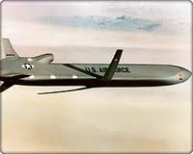
Cruse Missiles
Large Scale Weapons

Slide 18
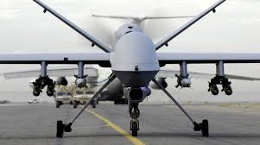
The Predator
Modern Day

Slide 19
Challenges of Airspace Integration
The “fear” factor
Privacy Concerns
The “creep factor”
Civil Liberties
Safety

Slide 20
A look back into Aerospace History

Slide 21
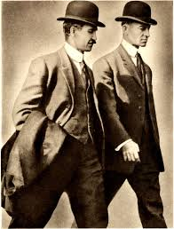
It all started with the Wright Brothers…
Wilber and Orville

Slide 22
Ohio Birthplace of Aerospace Science

Slide 23
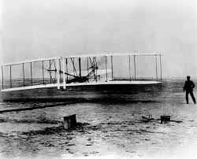
Wright Flyer
Kitty hawk 1903

Slide 24
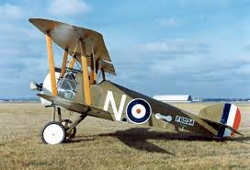
World War I

Slide 25
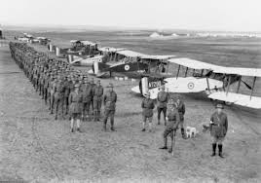
Signal Corps

Slide 26
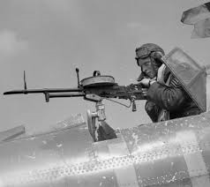
Guns and Bombs

Slide 27
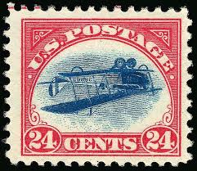
United States Mail

Slide 28
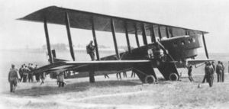
Passengers
1919

Slide 29
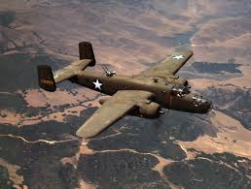
World War II More Guns and Bombs
B-25

Slide 30
Modern Aircraft

Slide 31
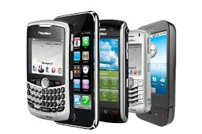
Why Now
The “fusion” of new technologies:
Micro Sensors
Firmware
Software
New Modulation Methods
GPS
Out runner Motors
LiPoly Batteries
Strong, lightweight materials

Slide 32
The PC World circa 1980
Remember?

Slide 33
IBM, Apple and Everyone Else

Slide 34
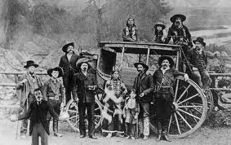
The Wild Wild West

Slide 35
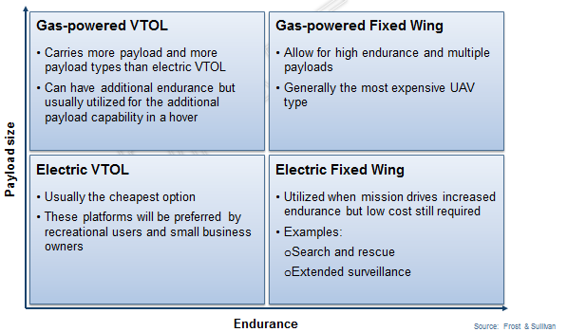
Sizes Today

Slide 36
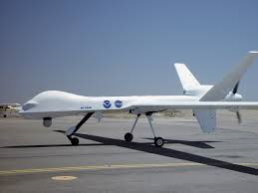
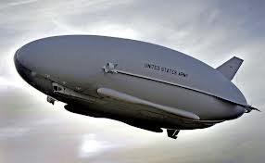
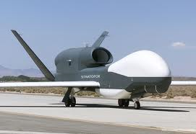
Large

Slide 37
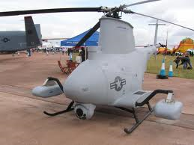
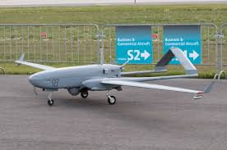
Medium

Slide 38
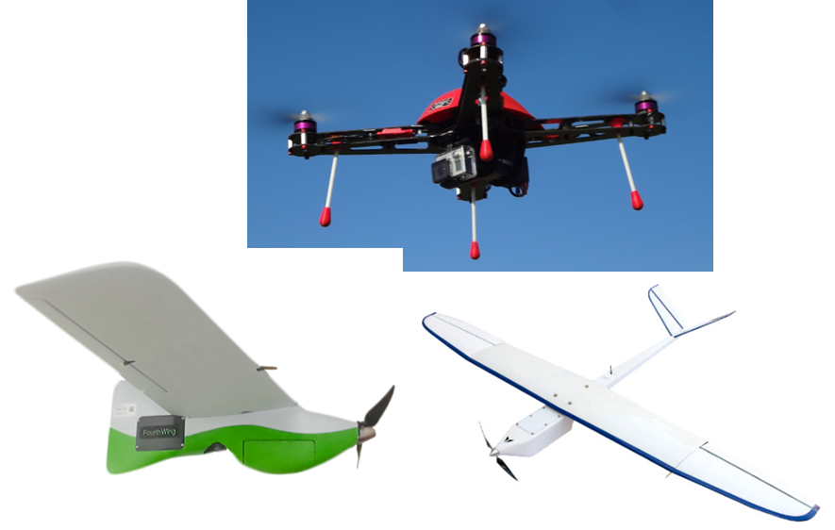
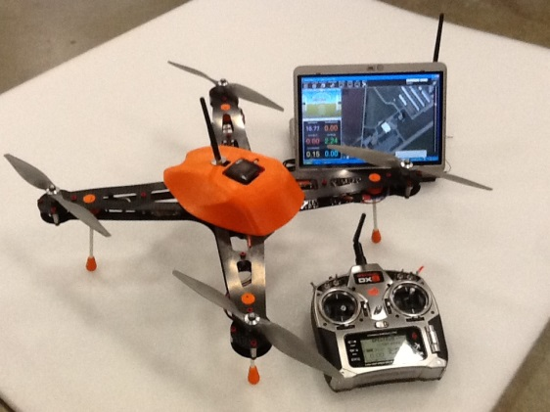
Small

Slide 39
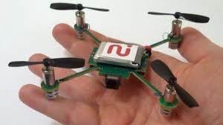
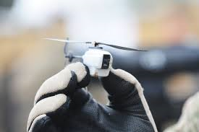
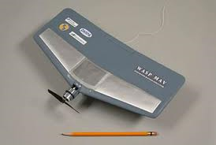
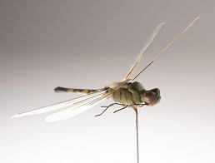
Micro

Slide 40
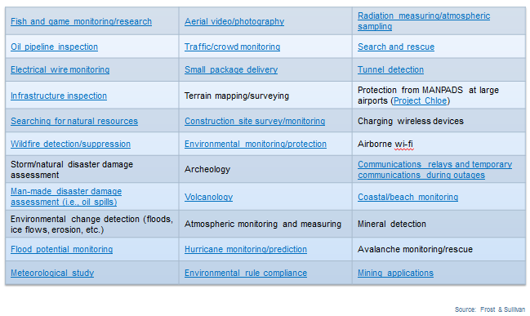
Applications Today

Slide 41
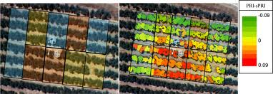
Precision Agriculture

Slide 42
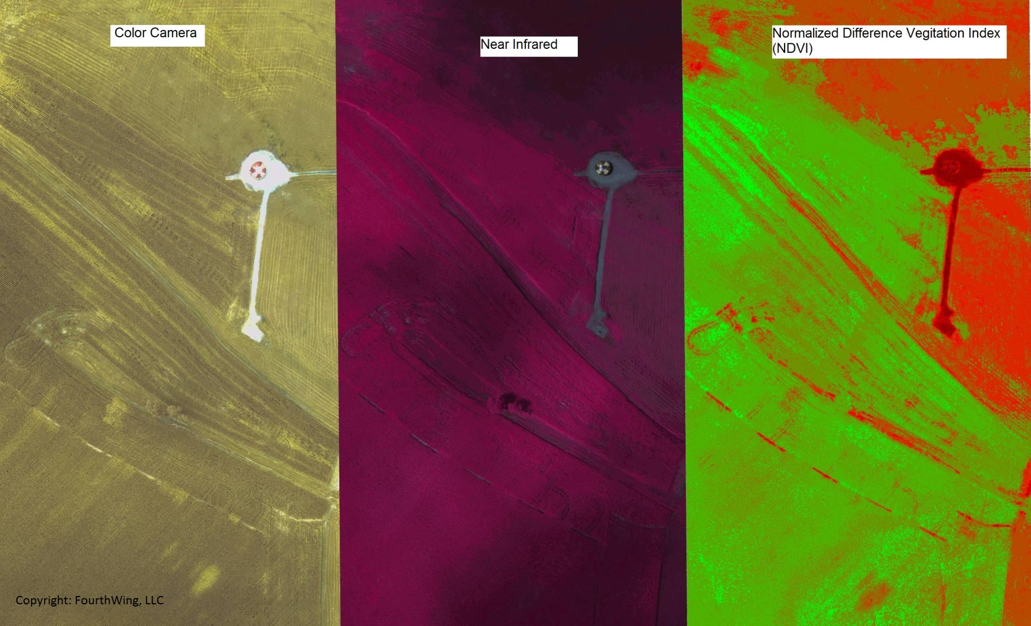
Precision Agriculture

Slide 43
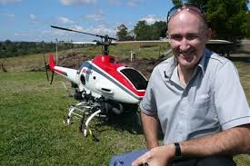
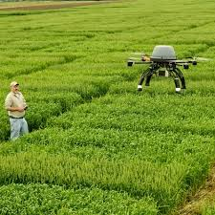
Agriculture Applications
Irrigation
Crop Moisture
Soil Moisture
Fertilizer Concentration
Mold
Bug Infestation
Chlorophyll Concentration
Feed Lot Inspection
Peak Harvest

Slide 44
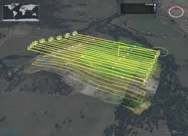
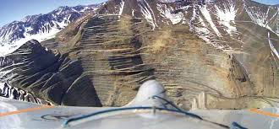
Mining

Slide 45
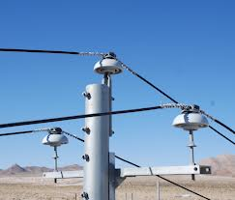
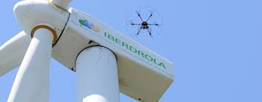
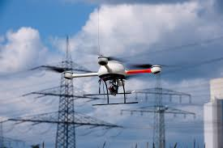
Power Line Inspection

Slide 46
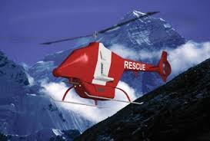
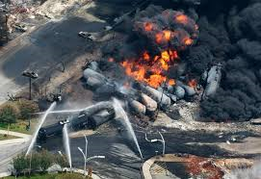
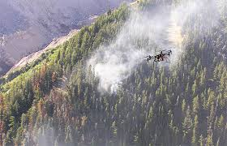
Emergency Services

Slide 47
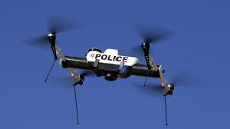
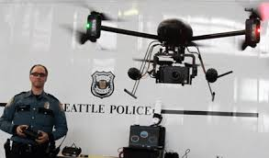
Law enforcement

Slide 48
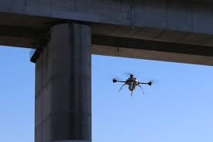
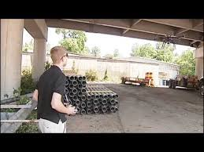
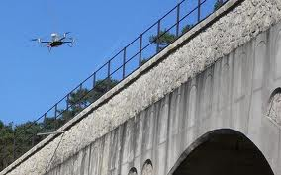
Bridge Inspection

Slide 49
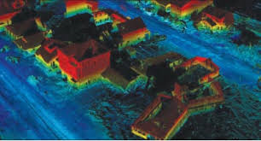
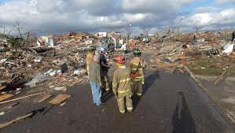
Disaster Assessment

Slide 50
UAS System Overview
The way a pilotless aircraft is controlled determines its categorization
Unmanned Aerial Vehicle (UAV): a pilotless aircraft that is either manually controlled with a joystick or a mouse or autonomously flown by following a preprogrammed mission.
Remotely Piloted Vehicle (RPV): a pilotless aircraft that is steered or controlled from a remotely located position. In many cases, the terms UAV and RPV are interchangeably used to describe any pilotless aircraft.
Drone: one of the oldest terms used to describe a pilotless aircraft. A drone is defined as a pilotless aircraft controlled by radio signal.
Notes:
Unmanned Aerial Vehicle (UAV): a pilotless aircraft that is either manually controlled with a joystick or a mouse or autonomously flown by following a preprogrammed mission. The acronym UAV is the most widely used term in describing a civilian pilotless aircraft.
Remotely Piloted Vehicle (RPV): a pilotless aircraft that is steered or controlled from a remotely located position. Manually controlled pilotless aircraft means manually controlling the aircraft position by manually adjusting its heading, altitude, and speed. In many cases, the terms UAV and RPV are interchangeably used to describe any pilotless aircraft.
Drone: one of the oldest terms used to describe a pilotless aircraft. A drone is defined as a pilotless aircraft controlled by radio signal. Even with the emerging of the UAV and RPV names, the name “drone” is still used even for civilian pilotless aircraft. For the purpose of this course, the word drone is used to describe a pilotless aircraft equipped with lethal payload. It is usually used by defense apparatus.

Slide 51
Thank You

